Slide 1
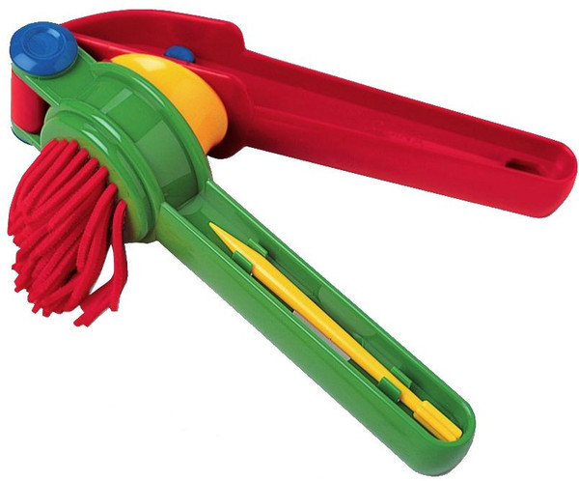
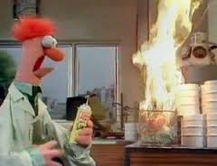
Physical
and
Chemical Changes
by Gabriel Edwards
home
next

Slide 2
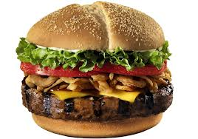
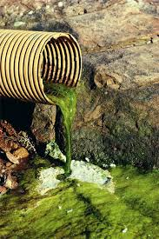
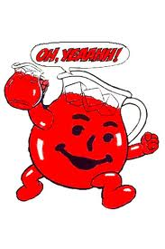
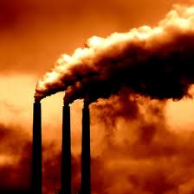
We constantly interact with the world around us. We write on our paper and then ball it up and throw it away; at the end of the year we may even burn it. We slice ham and cheese and we fry eggs. We freeze water and then let it melt in our glasses and we mix in kool aid and chew our sandwich. Each of those acts changes the material world around us and many of our actions have serious consequences. The many fuels that we burn to drive or for electricity change the world around us also.
But what kind of changes are they? Can we take them back and undo them? Or are they permanent? Well that all depends.
Lets learn about the two fundamental changes taking place and how they differ. As you move through this tutorial you should learn the difference between physical and chemical changes, the action verbs that help indicate what is occurring, what signs to look for as indicators of each type of change, the laws governing the changes in our world, and with a little luck, maybe one of you will find a solution to some of the problems created by our actions.
back
home
next

Slide 3
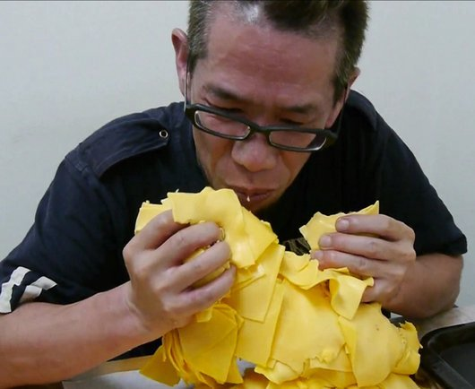
Physical changes are changes in the form of a substance that do not affect the substance’s chemical composition. For instance when you sliced your cheese for your sandwich you changed its shape but it still looks like cheese; it still smells like cheese; it still tastes like cheese. It must still be cheese. So although the cheese is now smaller and thinner, maybe even crumbled, torn, or melted it’s basic properties of color, taste, and smell that identify it as cheese have remained the same.
Changes of state are also physical changes. When water freezes it’s still water. When ice melts it’s still water. When water boils it’s still water.
back
home
next

Slide 4
The following videos show physical changes. Think about the properties (smell, taste, color) of the objects both before and after the experiments. In physical changes those properties should remain the same.
back
home
next

Slide 5
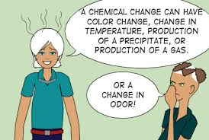
Chemical Changes are everywhere. We couldn’t exist without them. In a chemical change matter is taken apart and recombined to make something entirely different. Think about breathing, you’re doing it now. We all know that we breathe in oxygen and breathe out carbon dioxide; that’s a chemical change that you couldn’t live without (it’s called respiration.) In fact you couldn’t go for more than a few minutes without it.
Think about some other places in your life where that happens. You drink kool-aid and then urinate. You eat a cheeseburger but that’s not what comes out in the toilet! Those are definitely chemical changes. What used to smell and taste good and was full of a variety of colors becomes something entirely different...gross and stinky. Their basic properties have changed.
So what did change? What are the signs of a chemical change? Chemical changes often involve a change in color, odor, temperature (they can get cooler or warmer), production of a gas (excuse me), or formation of a precipitate.
back
home
next

Slide 6
As the last slide said, in a chemical change the substances involved (the reactants) are changed into something entirely new after the reaction with completely new properties
Here is a short video about how the properties of chemicals change after a chemical reaction. This one is particularly significant because you mix two poisons and end up with something that we can’t live without. No, two wrongs still don’t make a right.
back
home
next

Slide 7
Watch these videos to see some pretty extreme chemical changes. Think about what their properties were before the reaction, what happened during the reaction, and how their properties were different afterward.
back
home
next

Slide 8
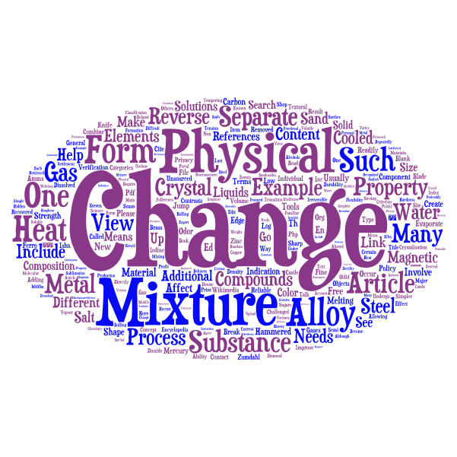
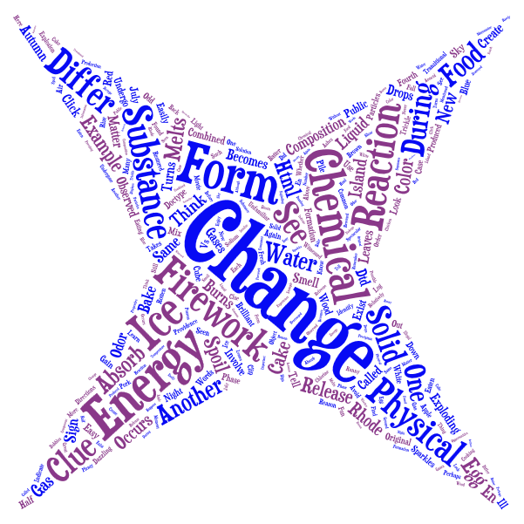
Certain verbs are more closely related to one form of change or the other. You can use those clues along with what you’ve already learned to help figure out which type of change you are observing.
Physical Change Verbs
Grind, dissolve, erode, rip, tear, break, melt, freeze, condense, boil, evaporate, sublimate, mix, cut, sort.
Chemical Change Verbs
Cook, burn, heats, cools, bubbles, precipitates, rusts, rotts, curdles, digests, tarnishes, glows, corrodes, explodes.
back
home
next

Slide 9
Now that you have a good idea about the differences between physical and chemical changes try your hand at answering the table to the right.. Remember to pay attention to the verb and the substance involved. Once you think you know the answer, highlight the cell to the right to check.
Changes | Highlight to reveal answer
Glass breaking | physical
Nailing wood to build a house | physical
A rusting bicycle | chemical
Melting butter for popcorn | physical
Separating sand from gravel | physical
Spoiling food | chemical
Making Kool-aid | physical
Mowing the lawn | physical
Corroding metal | chemical
Bleaching your hair | chemical
Use the Verb chart below to help you decide before checking your answer.
Physical Changes | Chemical Changes
Melt, Broke, Froze, Evaporate, Mix, Cut, Tear, Sort | Cooked, Burned, Exploded, Glowed, Corroded
back
home
next

Slide 10
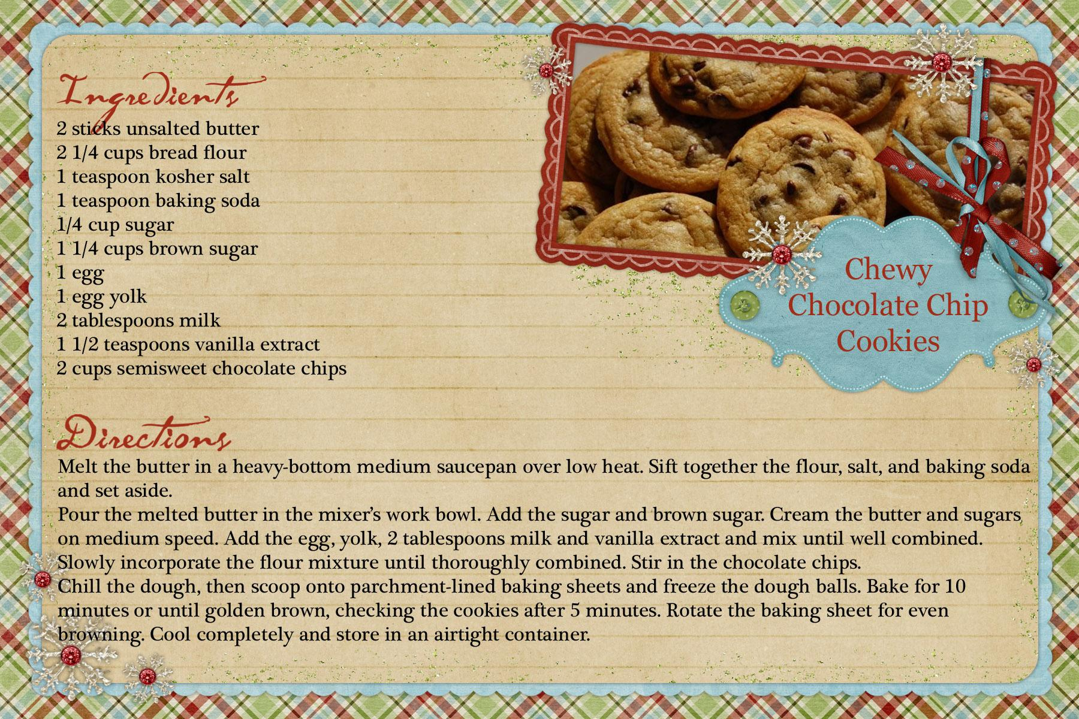
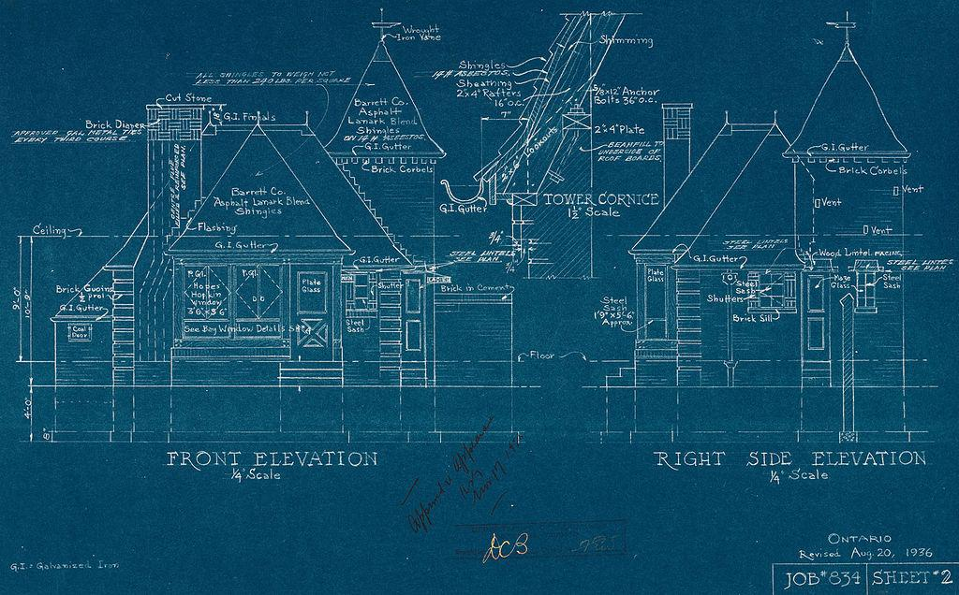
Now that you have an understanding of chemical changes let’s take a closer look at what’s happening inside. Amazingly chemists have have been able to break down all the things we see everyday into their individual parts; just like a house is made of wood, nails, and bricks or a cake is made of flour, eggs, milk, and sugar.
You’ve already seen that salt is made of Sodium (Na) and Chlorine (Cl). You probably also know that water is H2O or Hydrogen (H) and Oxygen (O) and that you breathe out Carbon Dioxide or CO2 or Carbon ( C ) and Oxygen (O). But you also know if you don’t put enough nails in the wood then your house will fall down and if you put too much salt in your cake no-one will eat it. So how do we get just the right amount of each?
A Chemical Formula is the recipe or blueprints of the stuff all around us and it must be properly balanced in just the same way.
back
home
next

Slide 11
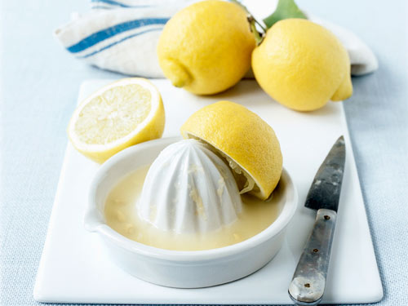
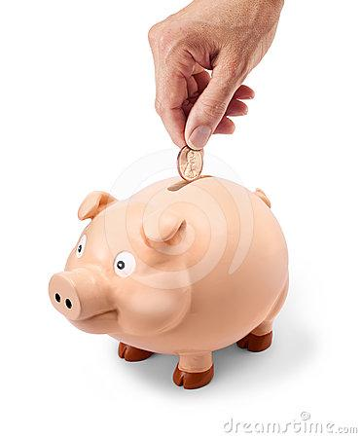
The Law of conservation of mass states that matter can neither be created nor destroyed. In other words the mass of the ingredients will be equal to the mass of the product (balanced). Keep that in mind when you’re working on chemical equations.
Below are some common idioms to help you remember the law of conservation of mass.
If life gives you lemons
make lemonade
A penny saved is a penny earned.
You’ve got to crack a few eggs to make an omelette.
back
home
next

Slide 12
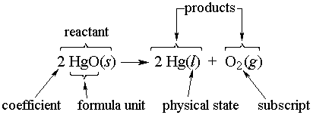
Chemical formulas and equations have different parts and it’s important to know the differences. To simplify, think of the reactants as the ingredients which will react with each other to make the product.
Between the reactants and the products is an arrow called the yields sign. It’s easiest to consider it as an equal sign in the chemical equation.
The subscripts are easy to remember since sub means below and they are both smaller and below the element they represent; it’s kind of like saying , “sugar- ¾ cup”. When balancing equations NEVER change the subscripts; that would change the whole recipe not just the size of the batch.
Coefficients are the large numbers in front of the elements. Coefficients are what you change in order to balance the formula.
back
home
next

Slide 13
Look above at the reactants on the left side of the yield sign; Notice how the totals of each ‘element’ is equal to the total of each element on in the product. Also pay attention to the coefficients used on the reactants in order to balance the numbers with the product side. Without the coefficients there might only be one graham cracker, one marshmallow, and one piece of chocolate resulting in something still rather tasty but messier and less satisfying than the complete S’more in the photo.
Use this color code formula for a more concrete understanding of the process before you move to the next few pages with some real equations to balance.
back
home
next

Slide 14
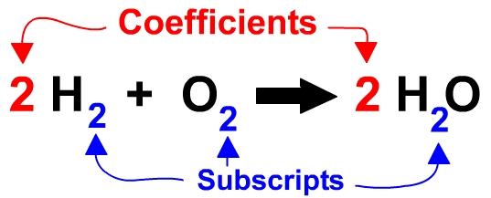
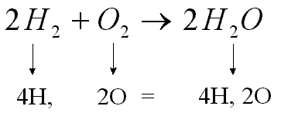
So if you wanted to make water as in the formula above you would need to start out with the correct ingredients which are Hydrogen and Oxygen. But in nature neither Hydrogen nor Oxygen float around as single atoms but instead pair up with themselves for stability. As you can see, this provides us with too much oxygen for the ratio of H to O that we need to make water, thereby creating an unbalanced equation. To fix this we must add the Coefficient of 2 (in red below) in two different places to ensure all parts are used without leaving any remainders to float around un-used.
If you then multiply your coefficients with their subscripts and compare, you can see below that you have balanced the equation.
back
home
next

Slide 15
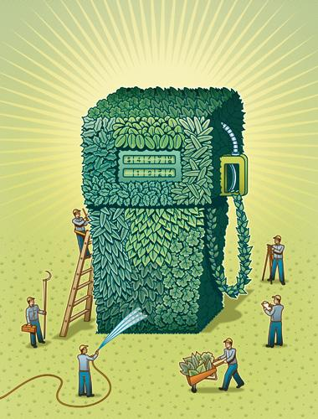
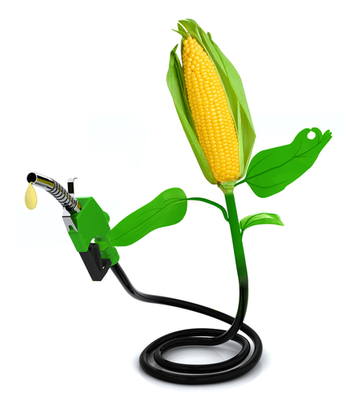
You now know the difference between physical and chemical changes, the indicators and cues to help identify those differences, the Law of Conservation of Mass, how it applies to chemical changes, and generally how to make sure those equations are balanced.
Now visit Mr.Guch for a few more pointers on balancing equations and then go to crecentok.com and PHET CO to get a little more practice and the next thing you know you’ll be creating cleaner burning fuels from renewable resources and getting rich for your discoveries.
back
home

